Slide 1
Leveraging Single Cell Data for Computational Drug Repurposing for Endometriosis
Simran kanal
Summer Symposium
Sirota lab – summer rotation'23
Notes:
Leveraging Single Cell Data for Computational Drug Repurposing for Endometriosis

Slide 2
OUTLINE
Overview on Endometriosis
Bulk cell transcriptomic analysis for drug repurposing
Single cell transcriptomic analysis
Bioinformatic approach
Introduction to dataset
Expected outcomes
Prospective plan
References

Slide 3
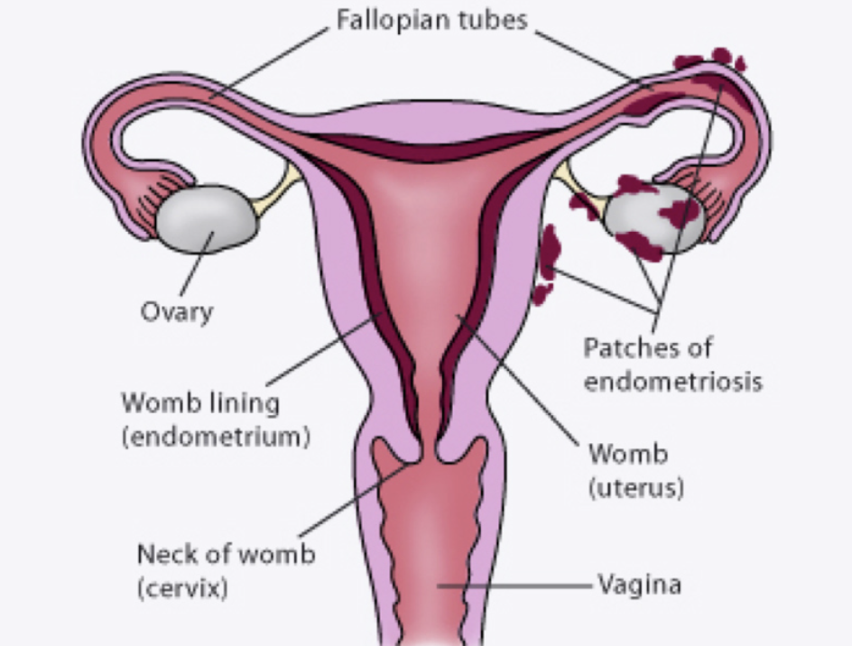
Endometriosis
Endometriosis
Research on Endometriosis
Combination therapy
Heterogeneity of symptoms
Delayed Diagnosis
Complex underlying mechanisms
Notes:
Endometriosis is a chronic and often painful gynecological disorder that occurs when tissue similar to the lining of the uterus (endometrium) grows outside the uterus. This tissue can develop on organs like the ovaries, fallopian tubes, and pelvic lining. During the menstrual cycle, the displaced tissue responds to hormonal changes by breaking down and bleeding, but because it's located outside the uterus, it has no natural way to exit the body. This can lead to inflammation, pain, scar tissue formation (adhesions), and fertility problems.
Lack of Biomarkers: There is a lack of definitive biomarkers for endometriosis, making accurate diagnosis and monitoring challenging. This can delay diagnosis and affect the reliability of research findings.
Heterogeneity of Symptoms: Endometriosis symptoms vary widely among individuals, ranging from mild to severe. This heterogeneity complicates both diagnosis and research standardization.
Delayed Diagnosis: Diagnosis is often delayed due to a lack of awareness among patients and healthcare providers, leading to longer periods of disease progression before intervention.
Complex Underlying Mechanisms: The exact cause of endometriosis is not well understood, and multiple factors likely contribute, including genetics, immune responses, and hormonal influences.
Research on endometriosis is crucial to improve diagnosis, develop targeted treatments, and enhance the quality of life for millions of individuals affected by this often-debilitating condition. Understanding its underlying mechanisms, identifying biomarkers, and finding more effective therapies can alleviate pain, reduce fertility challenges, and minimize the societal and economic burden of endometriosis.
Image via: https://www.google.com/url?sa=i&url=https%3A%2F%2Fthepelvicclinic.co.uk%2Fconditions-treatments%2Fendometriosis%2F&psig=AOvVaw2sGMYDi0cj4jUhWqbeq7Tq&ust=1692251294042000&source=images&cd=vfe&opi=89978449&ved=0CBEQjhxqFwoTCJi247u94IADFQAAAAAdAAAAABAE

Slide 4
Previous work : Bulk transcriptomics Drug Repurposing
A computational drug repurposing pipeline was applied to endometrial gene expression data in the setting of endometriosis and controls in order to identify potential therapeutics from existing drugs based on expression reversal.
A rat model was established to validate the NSAID fenoprofen, which was the top drug candidate, as a potential endometriosis therapeutic.
Oskotsky, Tomiko T, et al. Applying a Computational Transcriptomics-Based Drug Repositioning Pipeline to Identify Therapeutic Candidates for Endometriosis, 2022, https://doi.org/10.1101/2022.12.20.22283736.
Notes:
In this study, a computational drug repurposing pipeline was applied to an endometrial gene expression data in the setting of endometriosis and controls in an
unstratified manner as well as stratified by disease stage and menstrual cycle phase in order to identify potential therapeutics from existing drugs, based on expression reversal.
A method that was a pioneer by the research group was to use a pattern-matching strategy to identify drugs and diseases with reversed differential gene expression profiles — where genes downregulated in a disease are upregulated by the drug treatment and vice versa. This approach relies on transcriptomics data, which can be leveraged to generate profiles of gene changes for both drugs and diseases.

Slide 5
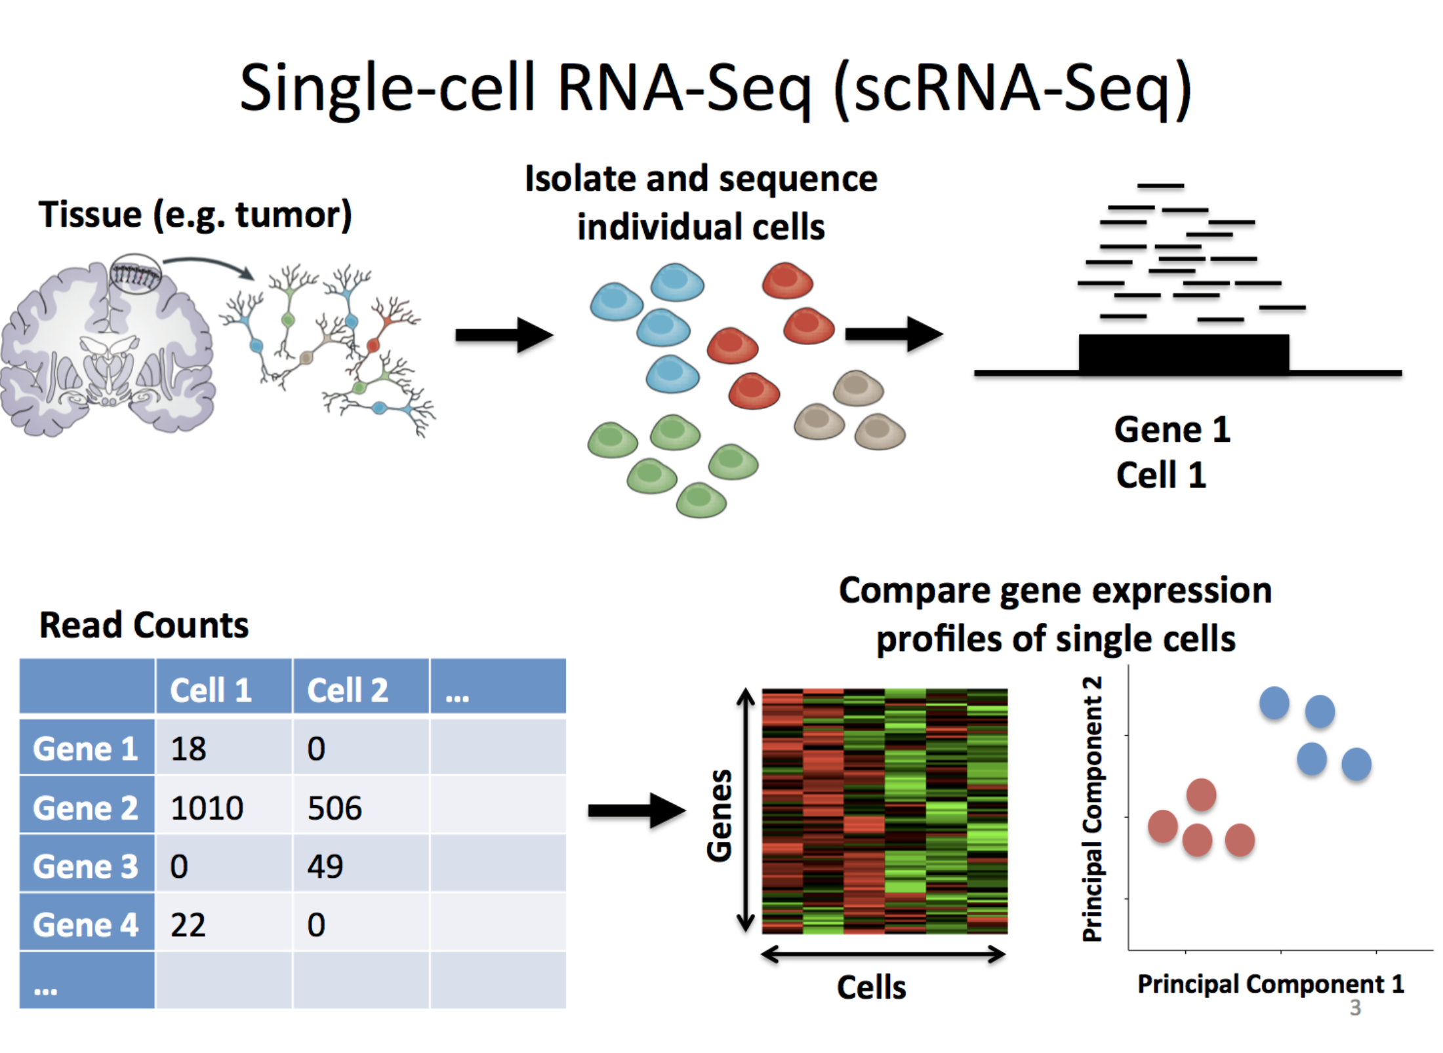
Single cell Transciptomics Profiling in Endometriosis
Single cell transcriptomics
Difference between Bulk and Single cell transcriptomic data
General idea of analysis
Benefits
Hypothesis
Notes:
Single-cell transcriptomics, allows for the analysis of gene expression at the individual cell level. This technique enables researchers to examine the heterogeneity among cells within a population and identify distinct cell types or subpopulations based on their gene expression profiles. Single-cell transcriptomics involves isolating individual cells, extracting RNA, and sequencing it. By analyzing the transcriptome of each cell separately, researchers gain insights into the unique gene expression patterns of individual cells.
Bulk cell transcriptomics is a traditional method used to analyze gene expression profiles in a population of cells as a whole. In this approach, RNA is extracted from a mixture of cells, and the resulting RNA is sequenced. This sequencing provides information on the collective gene expression levels of all the cells within the sample. Bulk transcriptomics provides an average representation of gene expression across the cell population but lacks information about individual cells.
A method that was a pioneer by the research group was to use a pattern-matching strategy to identify drugs and diseases with reversed differential gene expression profiles — where genes downregulated in a disease are upregulated by the drug treatment and vice versa. This approach relies on transcriptomics data, which can be leveraged to generate profiles of gene changes for both drugs and diseases.
Single-cell research is important because it offers unprecedented insights into the diversity and complexity of biological systems at the cellular level. By analyzing individual cells rather than bulk samples, researchers can uncover hidden heterogeneity, identify rare cell types, and understand cellular interactions which in the long run helps in better diagnosis and treatments.
Hypothesis(explain reversal score): A nonparametric rank-based method based on differential gene expression profiles using the Kolmogorov-Smirnov statistic 10. The hypothesis is that drugs with opposite transcriptional effects to those observed in endometriosis could potentially have a therapeutic effect in treating endometriosis.
Gene expression profiles from small-molecule drugs treated in various cell lines were obtained via CMap (connectivity map). Differential gene expression signatures for endometriosis were created across different stratifications, including stage and phase. Reversal scores were computed for each drug based on its gene expression relationship with the disease signature, with negative scores indicating reverse profiles and positive scores indicating similar profiles.
A reversal score based on the Kolmogorov–Smirnov statistic is generated for each disease-drug pair, with the idea that if the drug profile significantly reverses the disease signature, then the drug could be potentially therapeutic for the disease.
Image via: https://www.rna-seqblog.com/top-benefits-of-using-the-technique-of-single-cell-rna-seq/

Slide 6
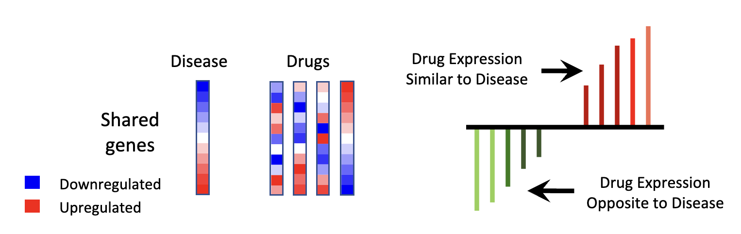
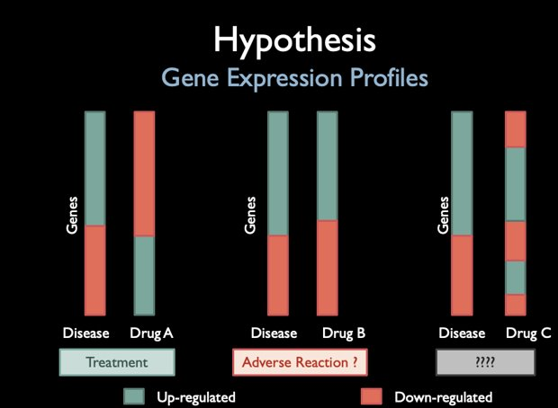
Computational Pipeline
What is computational pipeline
Hypothesis
Computational pipeline use with single cell analysis
Marina Sirota et al.,Discovery and Preclinical Validation of Drug Indications Using Compendia of Public Gene Expression Data.Sci. Transl. Med.3,96ra77-96ra77(2011).DOI:10.1126/scitranslmed.3001318
Notes:
Marina Sirota et al.,Discovery and Preclinical Validation of Drug Indications Using Compendia of Public Gene Expression Data.Sci. Transl. Med.3,96ra77-96ra77(2011).DOI:10.1126/scitranslmed.3001318
For each drug, the differential expression of the shared genes is compared to an input signature
Reversal score: non-parametric, rank-based method based on the Kolmogorov-Smirnov test
Hypothesis: Compounds that reverse the signature, might be therapeutic
1. **Data Collection**: Gene expression data is gathered from various sources, including public databases and experiments, to identify gene activity changes in endometriosis lesions and normal tissues.
2. **Data Integration**: Collected data is standardized and combined from different studies, ensuring compatibility for meaningful comparisons across sources.
3. **Differential Gene Expression Analysis**: Computational tools pinpoint genes with altered expression in endometriosis lesions, potentially offering therapeutic targets for the disease.
4. **Functional Annotation**: Annotated genes' roles are investigated to unveil underlying molecular processes and pathways involved in endometriosis.
5. **Drug Target Prediction**: Analyzed genes are assessed computationally for potential as drug targets, considering their interactions with known drugs or drug-like compounds.
6. **Drug Repurposing**: Computational screening identifies approved drugs or compounds that could be repurposed to target the identified genes associated with endometriosis.
7. **Validation and Experimental Testing**: Predicted treatments are rigorously tested in vitro or in vivo to confirm their effectiveness and safety for endometriosis treatment, a crucial step before clinical trials.
How I am modifying the pipeline for single cell data – will use the genes identify from bulk to begin with to narrow use
Image via: Vasighizaker, A., Danda, S. & Rueda, L. Discovering cell types using manifold learning and enhanced visualization of single-cell RNA-Seq data. Sci Rep 12, 120 (2022). https://doi.org/10.1038/s41598-021-03613-0

Slide 7
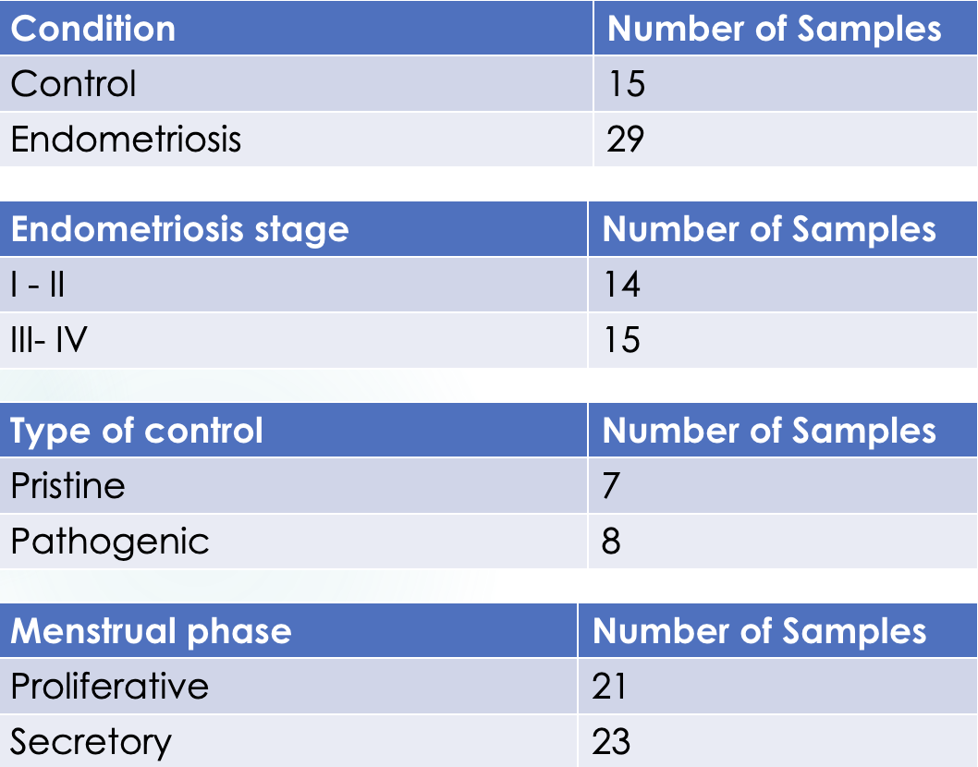
Endometriosis Single cell Transcriptomics Data
We have a total of 44 samples of SC (cases+ control)
Stage of endometriosis
Use of expression data
Identifying Biomarkers
Understanding Disease Mechanisms
Target Discovery for Therapies
Drug Development
Data analysis done by Laura Almonte
Notes:
So as we know, the endometrium is the tissue that lines the uterus and It has 2 major Phases (proliferative, secretory) --> which are cyclical
We are looking at the characteristic signatures for each cell type and phase
How many cases/controls: 44 samples of Single cell RNA seq with cases and controls.
Each sample was process with a specific fraction of cells, this was done in order to increase the immune cell population.
Read the table
Cycle phase
How is expression data used
Identifying Biomarkers: Differential gene expression analysis helps identify specific genes whose expression levels change significantly between different conditions. These genes can serve as biomarkers, indicating the presence of a disease or a response to a treatment.
Understanding Disease Mechanisms: By comparing gene expression profiles between disease and healthy samples, researchers can gain insights into the molecular mechanisms underlying the disease. This can lead to a better understanding of how the disease develops and progresses.
Target Discovery for Therapies: Differential expression analysis can highlight genes that play a crucial role in a disease. These genes may be potential therapeutic targets. Researchers can design treatments to modulate the expression or activity of these genes, aiming to mitigate the effects of the disease.
Drug Development: In drug discovery, differential gene expression data can help identify genes that are associated with a disease and potentially targeted by new drugs. It can also assist in assessing the effectiveness of candidate drugs by measuring their impact on gene expression.
Hypothesis(reversal)
#lauras slides (march'23)

Slide 8
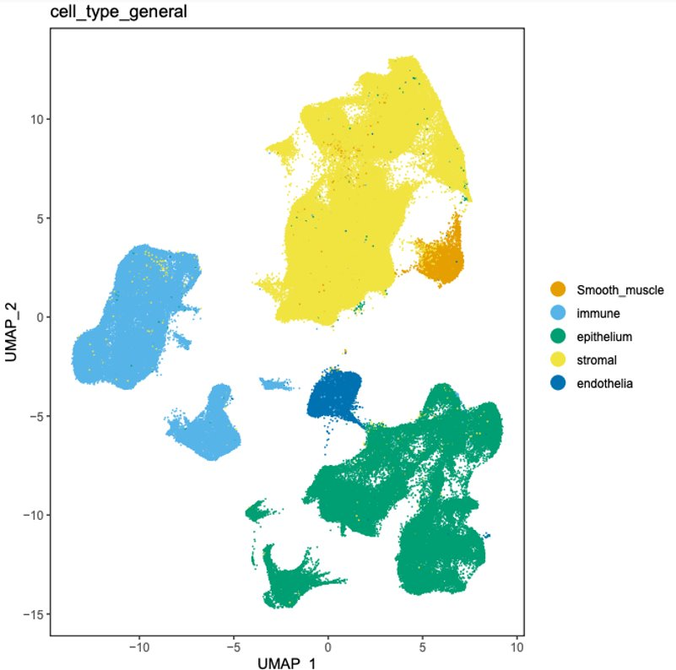
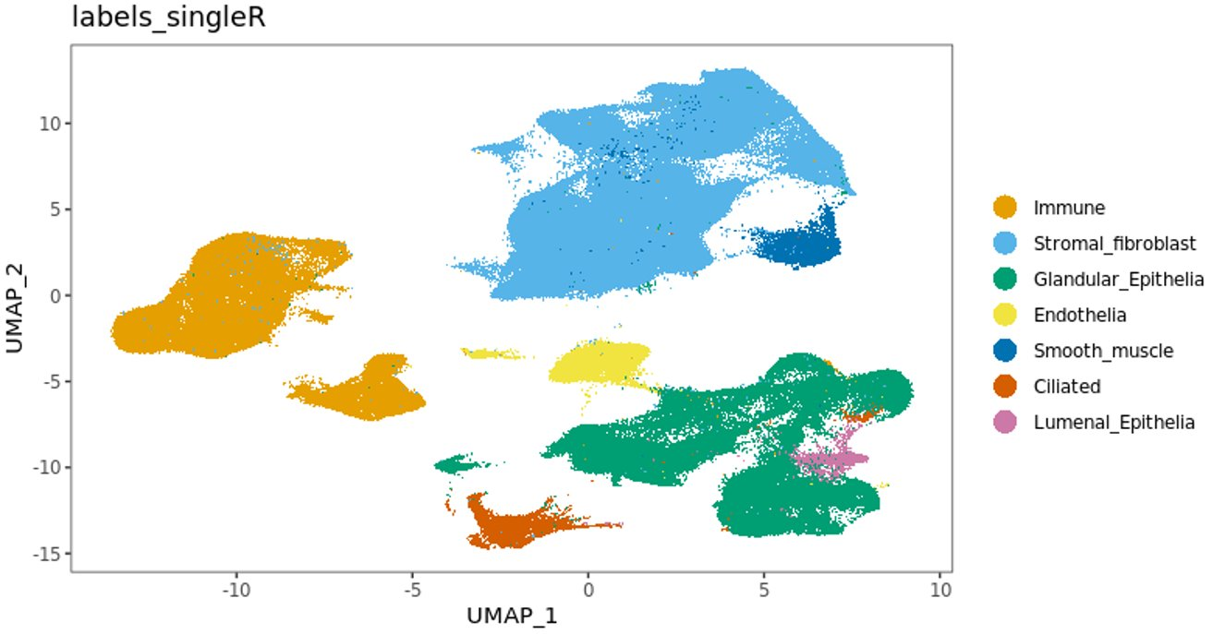
Annotation of Cell groups
Broad annotation shows 5 main cell groups
Focusing on epithelial cells reveals multiple subpopulations
Annotations done by Laura Almonte
Notes:
Wang W, Vilella F, Alama P, Moreno I, Mignardi M, Isakova A, Pan W, Simon C, Quake SR. Single-cell transcriptomic atlas of the human endometrium during the menstrual cycle. Nat Med. 2020 Oct;26(10):1644-1653. doi: 10.1038/s41591-020-1040-z. Epub 2020 Sep 14. PMID: 32929266. [ for finer analysis focusing on epithelial cells]

Slide 9
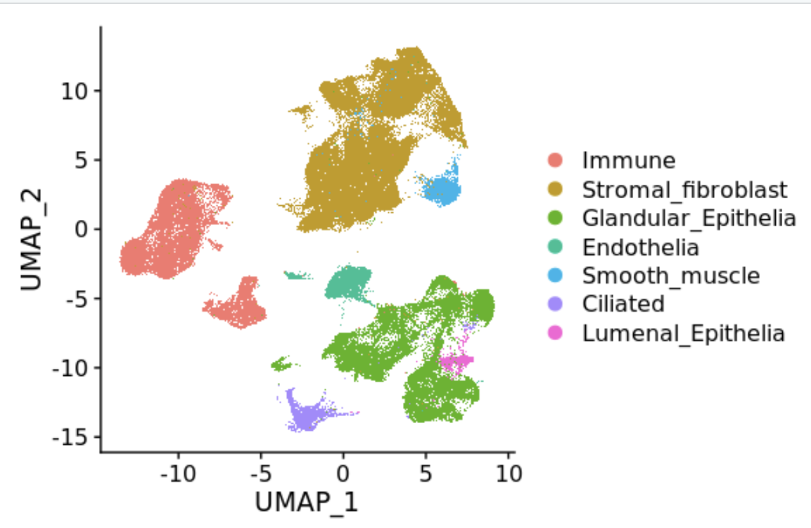
Fine Annotation using SingleR shows additional subpopulations
Gene signatures per cell type
Stromal: 5539 obs
Epithelial: 6948 obs
Endothelial: 6571 obs
Variables:
gene codes (X)
P-value
Avg_log2FC
Pct.1
Pct.2
Annotations done by Laura Almonte
Notes:
Did this suing as a reference wanxons data set
Wang W, Vilella F, Alama P, Moreno I, Mignardi M, Isakova A, Pan W, Simon C, Quake SR. Single-cell transcriptomic atlas of the human endometrium during the menstrual cycle. Nat Med. 2020 Oct;26(10):1644-1653. doi: 10.1038/s41591-020-1040-z. Epub 2020 Sep 14. PMID: 32929266.

Slide 10
Gene Signatures
Significant gene signatures per cell type
(when Avg_p-value is 0.05)
Significant gene signatures per cell type
(when AvgLog_2FC is 0.05)
Up&Down regulated gene signatures per cell type (stratified by avg_log2FC)
Stromal: 183 obs
Epithelial: 3704 obs
Endothelial: 6106 obs
Stromal:
up: 2023 obs | down: 3516 obs
Epithelial:
up: 2574 obs | down: 4374 obs
Endothelial:
up: 3088 obs |down:3483 obs
Stromal: 3542 obs
Epithelial: 4317 obs
Endothelial:4449 obs

Slide 11
Next Steps
Computational Identification of Drug Repurposing candidates (ongoing)
E.H.R analysis
Animal Model Validation
Identification of combination therapy

Slide 12


Thank you!
Giudice Linda
Irwin Juan
Sirota Marina
Oskotsky tomiko
Almonte laura
Li yaqiao

Slide 13
References
Oskotsky, Tomiko T, et al. Applying a Computational Transcriptomics-Based Drug Repositioning Pipeline to Identify Therapeutic Candidates for Endometriosis, 2022, https://doi.org/10.1101/2022.12.20.22283736.
Bunis DG, Wang W, Vallve´ -Juanico J,Houshdaran S, Sen S, Ben Soltane I,Kosti I, Vo KC, Irwin JC, Giudice LC and Sirota M (2022) Whole-Tissue Deconvolution and scRNAseq Analysis Identify Altered Endometrial Cellular Compositions and Functionality Associated With Endometriosis.Front. Immunol. 12:788315. doi: 10.3389/fimmu.2021.788315 ORIGINAL RESEARCH published: 05 January 2022 doi: 10.3389/fimmu.2021.788315
Vasighizaker, A., Danda, S. & Rueda, L. Discovering cell types using manifold learning and enhanced visualization of single-cell RNA-Seq data. Sci Rep 12, 120 (2022). https://doi.org/10.1038/s41598-021-03613-0
Wang W, Vilella F, Alama P, Moreno I, Mignardi M, Isakova A, Pan W, Simon C, Quake SR. Single-cell transcriptomic atlas of the human endometrium during the menstrual cycle. Nat Med. 2020 Oct;26(10):1644-1653. doi: 10.1038/s41591-020-1040-z. Epub 2020 Sep 14. PMID: 32929266.
Marina Sirota et al.,Discovery and Preclinical Validation of Drug Indications Using Compendia of Public Gene Expression Data.Sci. Transl. Med.3,96ra77-96ra77(2011).DOI:10.1126/scitranslmed.3001318

Slide 14
Questions
Thank you for your attention!

